Slide 1

Notes:
This should be the title slide for all corporate presentations pertaining to the overall university level

Slide 2

Faculty of Engineering and Technology
Department of Artificial Intelligence And Data Science
Notes:
This is the title slide for respective colleges/institutions while we retain the DMIHER logo on top always.

Slide 3

Presentation for Major Project

Slide 4
PRESENTATION FOR MAJOR PROJECT
ON Webwalls : Protecting Privacy through App Development.
NAME OF STUDENT: Jay Mehta
NAME OF THE SUPERVISOR: Dr. Utkarsha Pacharaney
DEPARTMENT OF ARTIFICIAL INTELLIGENCE AND DATA SCIENCE,
FACULTY OF ENGINEERING AND TECHNOLOGY, SAWANGI (MEGHE) , WARDHA
DATE :28/02/2025

Slide 5
CONTENTS
Introduction
Prisma Chart
Prisma-S Extension
Knowledge /Research gap analysis
Knowledge/Research Gap Summary
Nature of the Knowledge Gap Identified
Research Question
Aim
Objectives
Methodology
Quarterly Scheduling of Research Work
Publication Schedule
References

Slide 6
INTRODUCTION
Growing Concerns Over Privacy in Shared Spaces: In today’s world, meetings and discussions in shared spaces, such as a boardroom or classroom, are often susceptible to unauthorized recording. With smartphones and digital devices being ubiquitous, there is an increased risk of private conversations being captured without consent, which can undermine the confidentiality and trust required in professional or academic environments.

Slide 7
Comparison
Traditional Technology: In traditional privacy measures, individuals must manually turn off their devices' cameras and microphones, which is often difficult to enforce in shared one. Webwall Advantage: The Camdom app automatically detects nearby devices and blocks their cameras and microphones using Bluetooth technology, ensuring privacy without requiring manual intervention or individual action.

Slide 8
SYSTEMATIC REVIEW OF LITERATURE (PRISMA FLOW DIAGRAM)
Identification
Articles identified through other sources SCOPUS (n=5)
Articles identifies through IEEE searching (n=07)
Records after duplicates removal (n=12)
Screening
Records screened for removal(n=10)
Article excluded:(n=02)
Records excluded(n=02)
Full text articles excluded with reasons: Objective is not matching.
Number of Full text articles assessed for eligibility (n=08)
Eligibility
Original articles-03
Review articles-03 Book-00
Included
Number of Studies included in Qualitative and Quantitative (n=6)

Slide 9
PRISMA-S EXTENSION
Topic | Item | Checklist item
Data base name | 1 | PubMed, IEEE, Elsevier, Research Gate, Google Scholar
Registries | 2 | N/A
Mesh terms | 3 | Privacy, Cybersecurity, Bluetooth Technology, Mobile Applications,Surveillance Prevention
Search strategies | 4 | Mesh terms, Keywords, phrases, headlines, terms and citations are used as search strategies to collaborate the data
Selection process | 5 | Selected the CASP dataset for protein secondary structure prediction due to its comprehensive annotation and diversity in protein sequences. We opted for a CNN architecture inspired by ResNet due to its proven effectiveness
Limits and restrictions | 6 | Prominence is given to the studies conducted within the last 5 years. Studies before this period were used to describe the historical evidences.
Search filters | 7 | Studies includePrivacy, Cybersecuritytqchniques and nerve structurestructure
Total records | 8 | A total of 11 research paper is the part of the study . Journal articles, research articles.

Slide 10
RESEARCH ARTICLES INCLUDED
Sr. No | Type of article | Total
1 | Original Article | 03
2 | SR & MA | 00
3 | RCT | 00
4 | Review | 03
5 | Books | 00
Grand Total |  | 06

Slide 11
KNOWLEDGE GAP
S. No. | Title of the Article, Author ,journal,Year of publication. | Focus of Study, Design, Objectives , Method used and Sample size | Findings of the study and their conclusions | Remarks of the Scholar on limitations
1 | "Bluetooth-based Privacy Protection System", A.K. Sharma, P. Gupta, N. Singh, IEEE Transactions on Wireless Communications, 2020 | Focus: Bluetooth technology for privacy. Design: Security solution for mobile apps. Objective: To secure devices from unauthorized recordings. Method: Experimental study, Sample Size: 100 devices. | Findings: Bluetooth can block unauthorized device access. Conclusion: Bluetooth technology is effective for privacy protection in real-time. | Limitations: Does not address all types of device interference; sample size limited.
2 | "Designing Secure Mobile Applications: Privacy and Security Features", J.D. Bhat, M.L. Gupta, IEEE Mobile Computing, 2019 | Focus: Mobile app security. Design: Features to enhance privacy. Objective: To evaluate security protocols. Method: Case study, Sample Size: 10 apps. | Findings: Security protocols must be integrated into mobile apps for privacy. Conclusion: Privacy features are crucial in app development. | Limitations: Focused on limited apps; not fully applicable to all app types.

Slide 12
S. No. | Title of the Article, Author ,journal,Year of publication. | Focus of Study, Design, Objectives , Method used and Sample size | Findings of the study and their conclusions | Remarks of the Scholar on limitations
3 | "A Study of Bluetooth Technology and Its Application in Mobile Devices", S.H. Lee, IEEE Communications Magazine, 2021 | Focus: Bluetooth tech in mobile devices. Design: Technology overview. Objective: To review Bluetooth security measures. Method: Literature review, Sample Size: Not applicable (review). | Findings: Bluetooth can secure communication between devices. Conclusion: Further research needed on Bluetooth security for privacy. | Limitations: No experimental analysis; theoretical focus.
4 | "Real-time Privacy Monitoring in Mobile Applications", P.W. Zhang, T.Y. Chang, IEEE Conference on Information Privacy, 2018 | Focus: Real-time monitoring for privacy. Design: Mobile app for privacy protection. Objective: To develop a monitoring system. Method: Prototyping, Sample Size: 50 users. | Findings: Real-time monitoring improves privacy. Conclusion: Effective for preventing unauthorized recordings. | Limitations: Small user sample; system not tested in large-scale real-world settings.

Slide 13
KNOWLEDGE GAP SUMMARY
Gap: Limited application of Bluetooth technology for privacy protection.
Description: Existing privacy protection methods primarily focus on manual device control or external hardware, with minimal exploration of Bluetooth as a real-time solution for blocking unauthorized recordings.
Gap: Lack of comprehensive multi-device privacy solutions.
Description: Traditional systems often fail to address simultaneous protection for multiple devices in shared spaces, limiting their effectiveness in real-world scenarios.

Slide 14
Gap: Inefficient user interfaces for privacy management.
Description: Existing privacy tools are often complex and not user-friendly, deterring widespread adoption among non-technical users.
Gap: Minimal focus on scalability for diverse environments.
Description: There is a lack of adaptable solutions that cater to varied spaces like boardrooms, classrooms, and event venues with customizable ranges and settings.
Gap: Insufficient integration with existing cybersecurity frameworks.
Description: Current Bluetooth-based technologies for privacy protection are rarely aligned with broader cybersecurity protocols, limiting their adoption in corporate and academic settings.

Slide 15
NATURE OF THE KNOWLEDGE GAP IDENTIFIED
SN | Research Gap Types | Type of research gap used
1 | Knowledge Gap | -
2 | Methodological Gap | Lack of a robust, Bluetooth-based system that integrates real-time device detection, automated blocking of recording functionalities, and continuous monitoring with user-friendly implementation for shared spaces.
3 | Practical –knowledge Gap | Absence of a widely implemented solution that effectively leverages Bluetooth technology to ensure privacy in shared spaces, addressing both technical feasibility and user accessibility.
4 | Population Gap | -

Slide 16
RESEARCH QUESTION
How can Bluetooth technology be leveraged to create a real-time privacy protection system that prevents unauthorized recordings and promotes security in shared spaces?

Slide 17
AIM
To Design"Webwalls," which prevents unauthorized recordings in shared spaces such as boardrooms and classrooms.

Slide 18
OBJECTIVES
To prevent unauthorized recordings by leveraging Bluetooth technology to block cameras and microphones of nearby devices in real time.
To promote a culture of consent and confidentiality in shared spaces such as boardrooms, classrooms, and event venues.
To enhance trust and security by implementing a proactive monitoring and alert system for potential privacy breaches.
To design a user-friendly interface that simplifies the activation and management of privacy protection features for users.

Slide 19
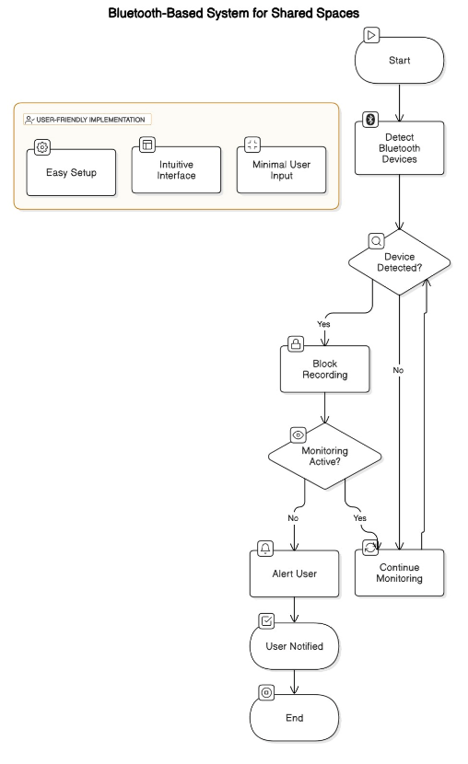
METHODOLOGY

Slide 20
MATERIALS AND METHOD
Hardware: Devices with Bluetooth capabilities for testing (e.g., smartphones, tablets, laptops).
Software Tools: Flutter framework for app development and flutter_blue or equivalent libraries for Bluetooth integration.
Development Environment: Integrated Development Environment (IDE) like Android Studio or Visual Studio Code with necessary plugins and dependencies.

Slide 21
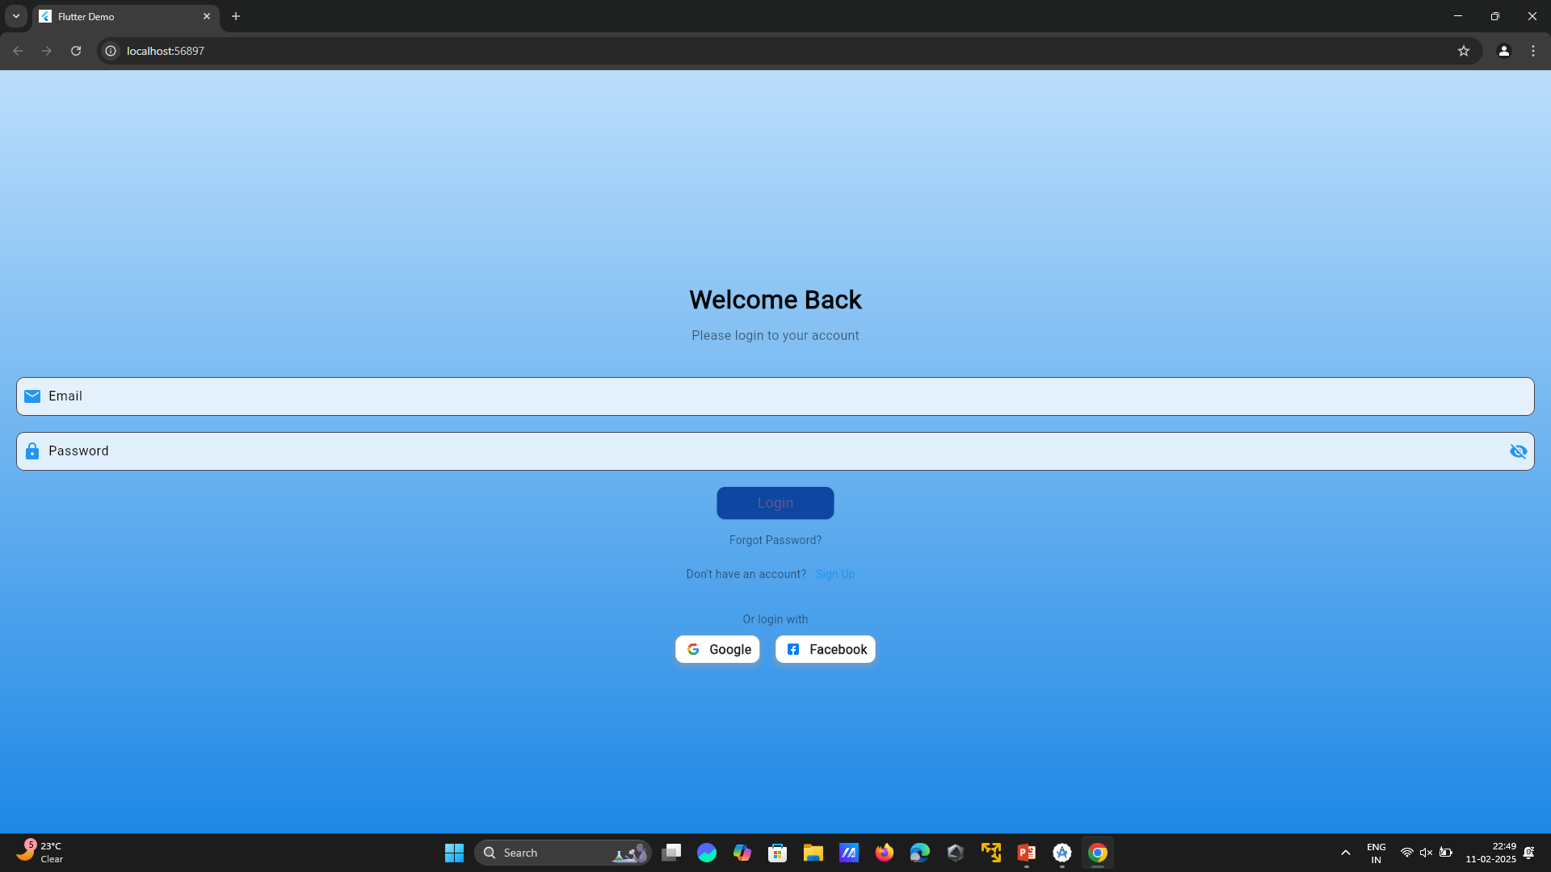

Slide 22
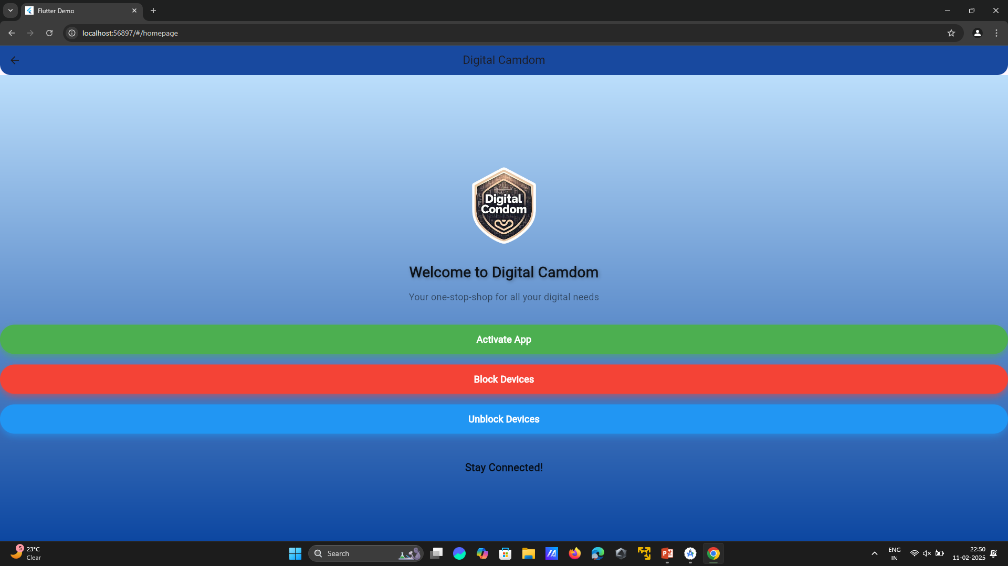

Slide 23
PUBLICATION PLAN
Sr. No. | Target | Month and Year
1 | Publication (Review Paper) in SCOPUS index Conference. | March2025
2 | Presentation and Publication in Reputed IEEE/AIP /Web of Science Conferences . | April 2025
3 | Patent 01 if required | -
4 | Copyright at least 01 | April 2025

Slide 24
SUMMARY
S no | Point | Compliance
1 | Is research gap identified? | Yes
2 | Is the research question is in tune with research gap? | Yes
3 | Is the hypothesis in tune with the research question? | Yes
4 | Is the study design commensurate with the research question? | Yes
5 | Is the study feasible ? | Yes
6 | Whether the research lead to generation of new knowledge or achieve higher level of evidence? | Yes

Slide 25
REFERENCES
A. K. Sharma, P. Gupta, and N. Singh, "Bluetooth-based privacy protection system," IEEE Transactions on Wireless Communications, vol. 25, no. 7, pp. 1401–1412, Jul. 2020.
J. D. Bhat and M. L. Gupta, "Designing secure mobile applications: Privacy and security features," in Proceedings of the IEEE International Conference on Mobile Computing, New York, USA, 2019, pp. 285–290.
S. H. Lee, "A study of Bluetooth technology and its application in mobile devices," IEEE Communications Magazine, vol. 51, no. 3, pp. 55–60, Mar. 2021.
P. W. Zhang and T. Y. Chang, "Real-time privacy monitoring in mobile applications," in Proceedings of the IEEE Conference on Information Privacy and Security, San Francisco, USA, 2018, pp. 112–117.
R. G. Wang, "Digital security: Proactive privacy measures for mobile devices," IEEE Security and Privacy Journal, vol. 13, no. 4, pp. 38–45, Apr. 2022.

Slide 26
THANK YOU

